Slide 1



Wireless LAN Operations
Presentation_ID

Slide 2
Wireless LAN Operations
Wireless 802.11 Frame
Wireless LAN Operations
CSMA/CA
Wireless Clients and Access Point Association
Association Parameters
Discovering Aps
Authentication
Channel Management
Frequency Channel Saturation
Selecting Channels
Planning WLAN Deployment
Summary
Presentation_ID

Slide 3
Objectives
▪▪ Describe wireless Frame types.
▪▪ Describe the content method used in a wireless environment.
▪▪ Describe association process.
▪▪ Describe channel management
▪▪ Describe WLAN deployment plan
Presentation_ID

Slide 4
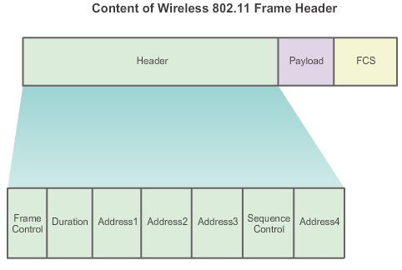
Wireless 802.11 Frame
802.11 Frame Structure
Presentation_ID

Slide 5
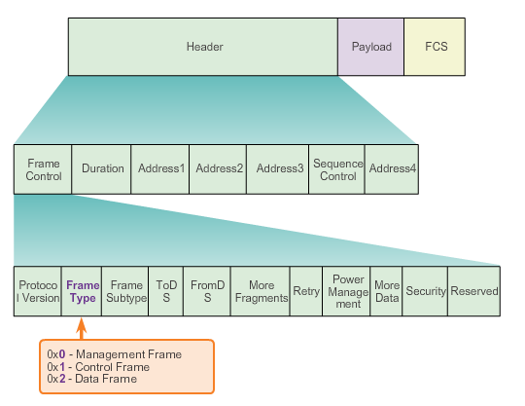
Wireless Frame Type
802.11 Frame Structure
Presentation_ID

Slide 6
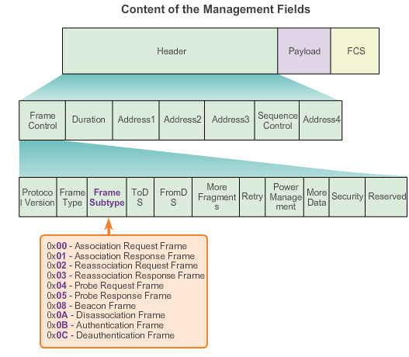
Management Frames
802.11 Frame Structure
Presentation_ID

Slide 7
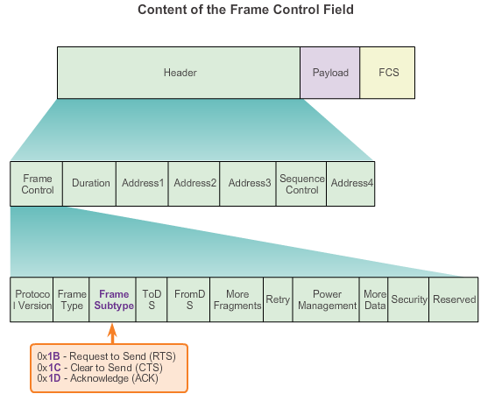
Control Frames
802.11 Frame Structure
Presentation_ID

Slide 8
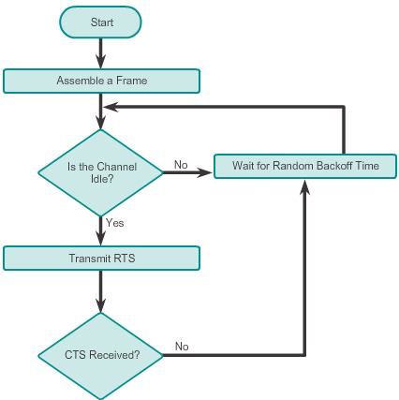
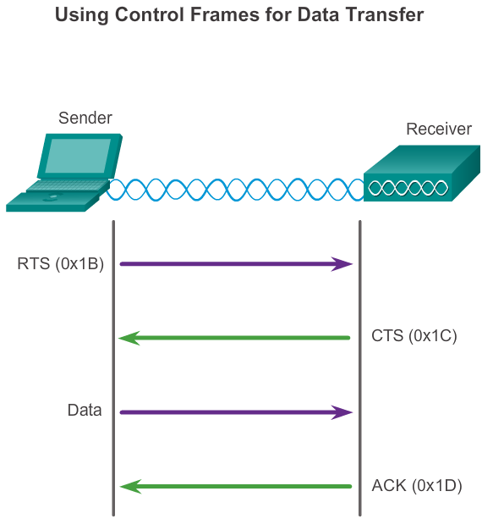
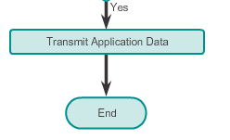
Wireless Operation
CSMA/CA
CSMA/CA
Flowchart
Presentation_ID

Slide 9
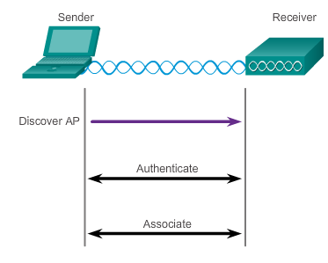
Wireless Clients and Access Point Association
Wireless Operation
Figure 1
Presentation_ID

Slide 10
Association Parameters
Wireless Operation
▪▪ SSID – Unique identifier that wireless clients use to distinguish between multiple wireless networks in the same vicinity.
▪▪ Password – Required from the wireless client to authenticate to the AP. Sometimes called the security key.
▪▪ Network mode – Refers to the 802.11a/b/g/n/ac/ad WLAN standards. APs and wireless routers can operate in a mixed mode; i.e., it can simultaneously use multiple standards.
▪▪ Security mode – Refers to the security parameter settings, such as WEP, WPA, or WPA2.
▪▪ Channel settings – Refers to the frequency bands used to transmit wireless data. Wireless routers and AP can choose the channel setting or it can be manually set.
Presentation_ID
10

Slide 11
Discovering APs
Wireless Operation
Passive mode
▪▪ AP advertises its service by sending broadcast beacon frames containing the SSID, supported standards, and security settings.
▪▪ The beacon’s primary purpose is to allow wireless clients to learn which networks and APs are available in a given area.
Active mode
▪▪ Wireless clients must know the name of the SSID.
▪▪ Wireless client initiates the process by broadcasting a probe request frame on multiple channels.
▪▪ Probe request includes the SSID name and standards supported.
▪▪ May be required if an AP or wireless router is configured to not broadcast beacon frames.
Presentation_ID

Slide 12
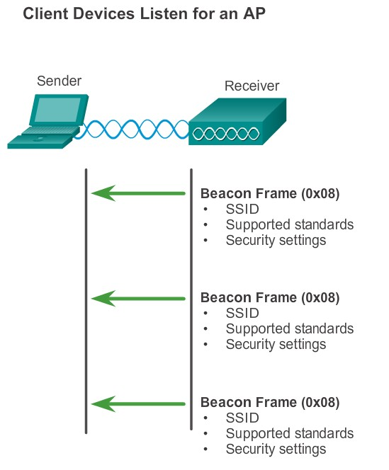
Discovering APs
Wireless Operation
Figure 1
Presentation_ID

Slide 13
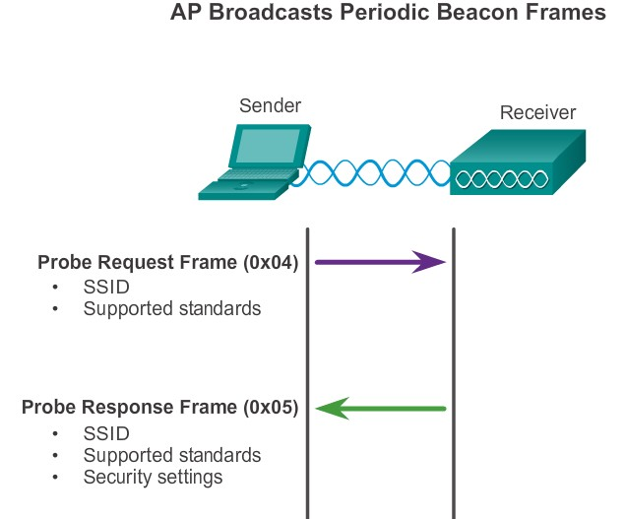
Discovering APs
Wireless Operation
Figure 2
Presentation_ID

Slide 14
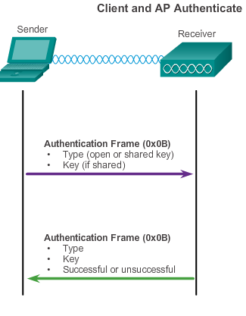
Authentication
Wireless Operation
▪▪ Open authentication – A NULL authentication where the wireless client says “authenticate me” and the AP responds with “yes.” Used where security is of no concern.
▪▪ Shared key authentication – Technique is based on a key that is pre-shared between the client and the AP.
Presentation_ID

Slide 15
Frequency Channel Saturation
Channel Management
Direct-sequence spread spectrum (DSSS)
▪▪ Uses spread-spectrum modulation technique; designed to spread a signal over a larger frequency band making it more resistant to interference.
▪▪ Used by 802.11b.
Frequency-hopping spread spectrum (FHSS)
▪▪ Relies on spread-spectrum methods to communicate.
▪▪ Transmits radio signals by rapidly switching a carrier signal among many frequency channels.
▪▪ This channel-hopping process allows for a more efficient usage of the channels, decreasing channel congestion.
▪▪ Used by the original 802.11 standard.
Presentation_ID

Slide 16
Frequency Channel Saturation (cont.)
Channel Management
Orthogonal Frequency-Division Multiplexing (OFDM)
▪▪ Subset of frequency division multiplexing in which a single channel utilizes multiple subchannels on adjacent frequencies.
▪▪ Because OFDM uses subchannels, channel usage is very efficient.
▪▪ Used by a number of communication systems, including 802.11a/g/ n/ac.
Presentation_ID

Slide 17
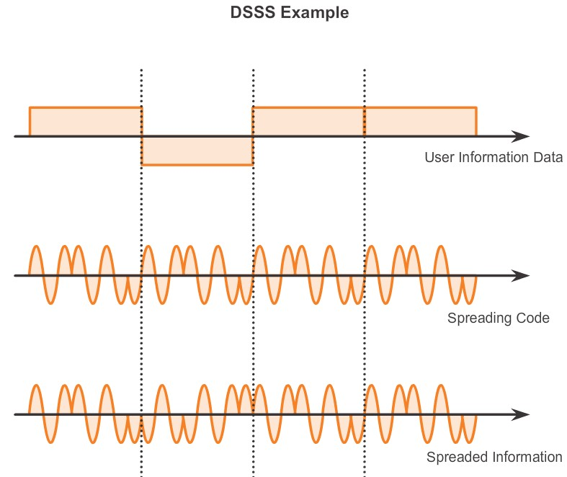
Presentation_ID

Slide 18
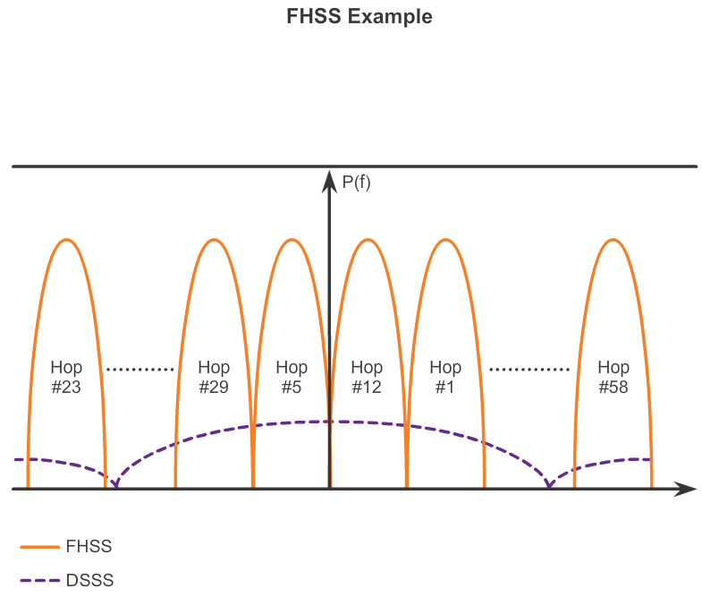
Presentation_ID

Slide 19
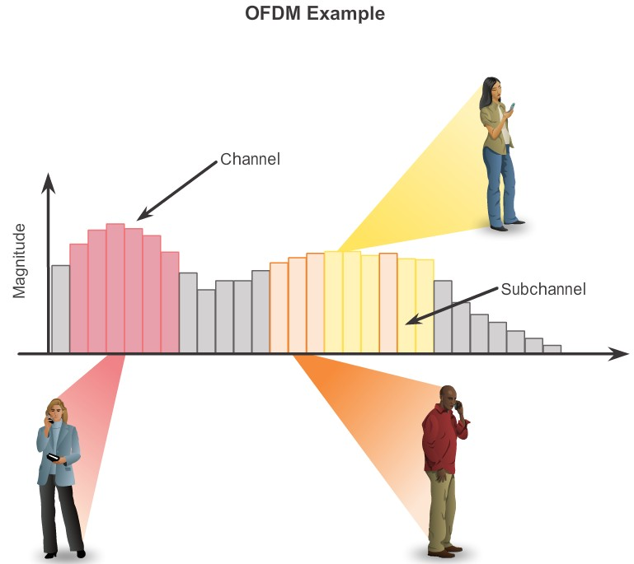
Presentation_ID

Slide 20

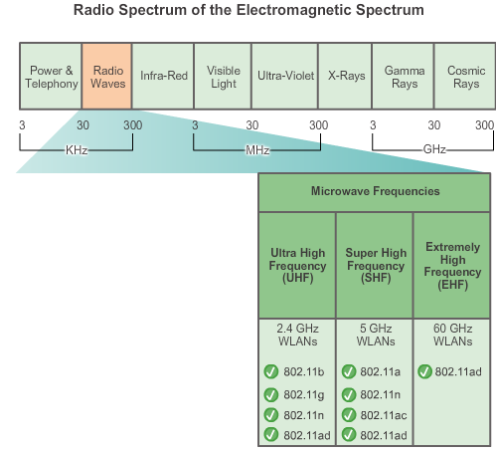
Selecting Channels
Channel Management
Figure 1 highlights which 802.11 standard operates in the 2.4 GHz, 5 GHz, and 60 GHz bands. Each spectrum is subdivided into channels with a center frequency and bandwidth, analogous to the way radio bands are subdivided.
Figure 1
Presentation_ID
20

Slide 21
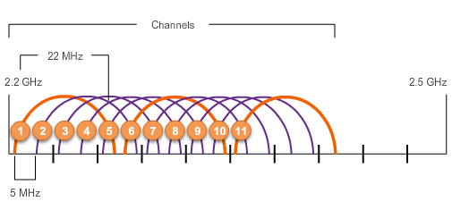
Selecting Channels (cont.)
Channel Management
The solution to 802.11b interference is to use nonoverlapping channels 1, 6, and 11.
Presentation_ID

Slide 22
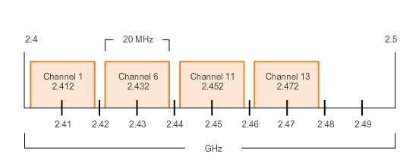
Selecting Channels (cont.)
Channel Management
Use channels in the larger, less-crowded 5 GHz band, reducing “accidental denial of service (DoS),” this band can support four non-overlapping channels.
Presentation_ID

Slide 23
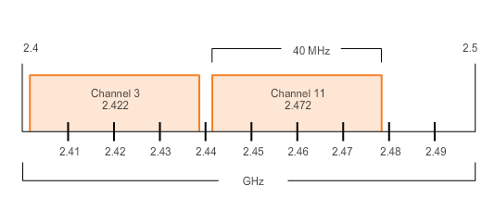
Selecting Channels (cont.)
Channel Management
Channel bonding combines two 20-MHz channels into one 40-MHz channel.
Presentation_ID

Slide 24
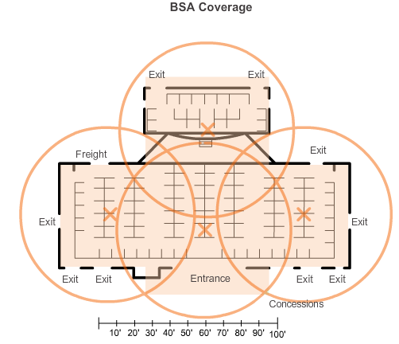
Planning a WLAN Deployment
Channel Management
▪▪ If APs are to use existing wiring, or if there are locations where APs cannot be placed, note these locations on the map.
▪▪ Position APs above obstructions.
▪▪ Position APs vertically near the ceiling in the center of each coverage area, if possible.
▪▪ Position APs in locations where users are expected to be.
Figure 1
Presentation_ID

Slide 25
Summary
▪▪ An STA first authenticates with an AP, and then associates with that AP.
▪▪ The 802.11i/WPA2 authentication standard should be used. Use the AES encryption method with WPA2.
▪▪ When planning a wireless network, nonoverlapping channels should be used when deploying multiple APs to cover a particular area.
There should be a 10–15 percent overlap between BSAs in an ESS.
▪▪ Cisco APs support PoE to simplify installation.
Presentation_ID

Slide 26

Presentation_ID

